Slide 1

Digital Marketing
The promotion of brands to connect with potential customers using the internet and other forms of digital communication.

Slide 2










Digital Marketing PPT
Various Channel Used
Content Marketing
Influencer Marketing
SEO
Viral marketing
Pay Per Click
Online Public Relations
Affiliate Marketing
Email Marketing
Social Media Marketing

Slide 3
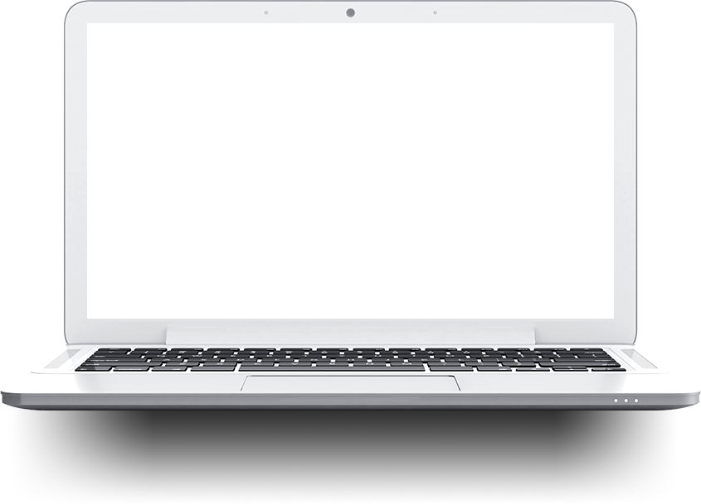

1. Blogs + Articles
250-1000 words short articles on “ hot topics”
2. SEO + Web Content
Optimize your website for google searches with good keywords
3. White papers
3,000 - 5,000 word case studies that position you as a thought leaser
4. E-Book
5,000 - 20,000 word In-depth books draw people to your website
5. Pay-per-Click campaigns
Pay to get listed at the top of the search engine results
Digital Marketing PPT
6. Specialized search engines
List products with chemical-specific search engines.
DM Strategy
7. Webinars
Online seminars to educate buyers about your products and their uses.

Slide 4
Digital Marketing PPT
Digital Marketing Channels In A Nutshell
SEM (Paid)
Google Ads
Bind Ads
Direct
Push
Email
Customer Base
SEO ( Organic)
Google
Bing
Yahoo
Referral
Affiliates
PR
SMM (Paid)
Facebook
Instagram
Pinterest
SMO (Organic)
Facebook Ads
Pinterest Ads

Slide 5
Digital Marketing PPT
Choosing The Best Digital Marketing Channel
1. Define your business goals
2. Define your audience
3. Test Channels
4. Analyze
5. Adapt
What are your business assets
What are your marketing assets
What is your budget
What are your goals
Learn about the audience
Use research tools to build audience persona
Understand your audience’s buying habits
Keep this in mind whenever you create new content
SEO & Content marketing
Paid advertising
Social media organic
Campaigns and paid ads
Email Marketing
Analyze ROI on each channel
Gather feedback
Learn from user’s behavior
Refine your campaigns
Come up with solutions
Stick to the most profitable channels
Co-ordinate your campaigns
Maximize your customer Acquisition

Slide 6
Digital Marketing PPT
Benefits Of Digital Marketing
Time & Effort Saving
Flexibility
Real-Time Analysis
Impactful
Economical
Instant Feedback

Slide 7
Digital Marketing PPT
Digital Marketing Objectives
Reach The Right Audience
Engage With Your Audience
Motivate Your Audience To Take Your Action
Maximize Return On Investment (ROI)

Slide 8
Digital Marketing PPT
Digital Marketing Objectives
Traffic Generation
Lead Promotion
Event promotion
Product selling
Branding
Reach
Increasing App Download
Interaction
Seasonal & Occasional Sales
Call Generation
Increasing Video view
Time-bound

Slide 9
Digital Marketing PPT
Pay Per Click
What is PPC (pay-per-click) marketing?
Pay-per-click marketing is a way of using search engine advertising to generate clicks to your website, rather than “earning” those clicks organically
Benefits Of PPC Advertising
01
03
Fast Measurable Results
You only pay for clicks
02
04
Get on the top spot of googles page 1 search results instantly
Traffic is targeted

Slide 10
Digital Marketing PPT
Social Media Marketing
What Is SMM?
Social media marketing (SMM) is a form of Internet marketing that utilizes social networking websites as a marketing tool. The goal of SMM is to produce content that users will share with their social network to help a company increase brand exposure and broaden customer reach.
Advantage Of SMM
01
03
Increased Brand Awareness
Improved Search Engine Rankings
02
04
Higher Conversion Rates
Better Customer Satisfaction
More Inbound Traffic

Slide 11
Digital Marketing PPT
Digital marketing Areas
SEO (Search Engine optimization)
SMO ( Social Media Optimization)
SEM (Search Engine Marketing)
SMM (Social Media Marketing)

Slide 12
Digital Marketing PPT
Promoting Brand Awareness
Internet
Online / Internet digital Marketing
TV
website
Mobile app
Search Engine
Social Media
Email
Referral
Radio
Mobile
Offline digital Marketing
TV
radio
Mobile
Out Of Home
Out Of Home

Slide 13
Digital Marketing PPT
DM Consist Of
Digital Marketing
SEM
Web Design
Video Production
Branding
Content Marketing
App Development
SEO
Email marketing
Social Media

Slide 14
Increase Lead Generation
Increase Sales Revenue
Improve Data Quality
Improve brand awareness
Digital Marketing PPT
DM Benefits
Benefits Of
Increase website traffic
Improve User experience

Slide 15





Thank You!

